Slide 1
8. Working with WordPress
ICT-Training Technical Skills

Slide 2
WordPress
Content management system.
WordPress is the simplest, most popular way to create your own website or blog.

Slide 3
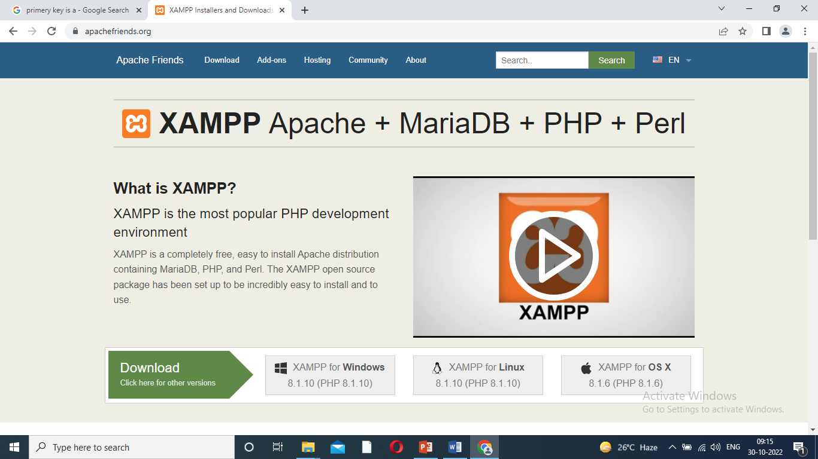
Downloading WordPress
Steps:
Installing word press.
Step:1
Download XAMPP server -https://www.apachefriends.org/dowmload.html.
X-windows operating system.
A-Apache
M-MySQL
P-PHP
P-Perl

Slide 4
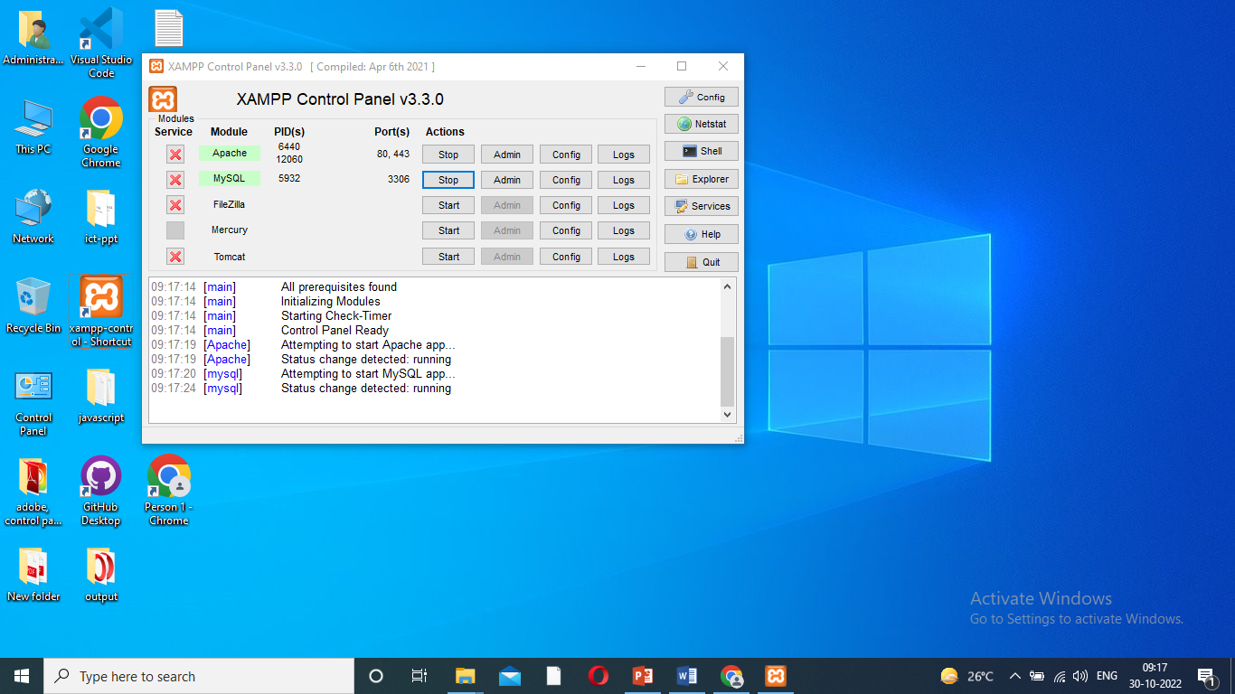
Downloading…
Step:2
Installed automatic server start.
C:\xampp-install-ok
C:\xampp=>xampp-control-short cut-desktop.

Slide 5
Downloading…
Step:3
Download word press from
https://wordpress.org/download – word press 6.0.3 – download.
Zip extract-copy.
C:xampp-htdoc-paste.
Root folder-hotdoc.
Word press-rename=``biodata or user name”

Slide 6
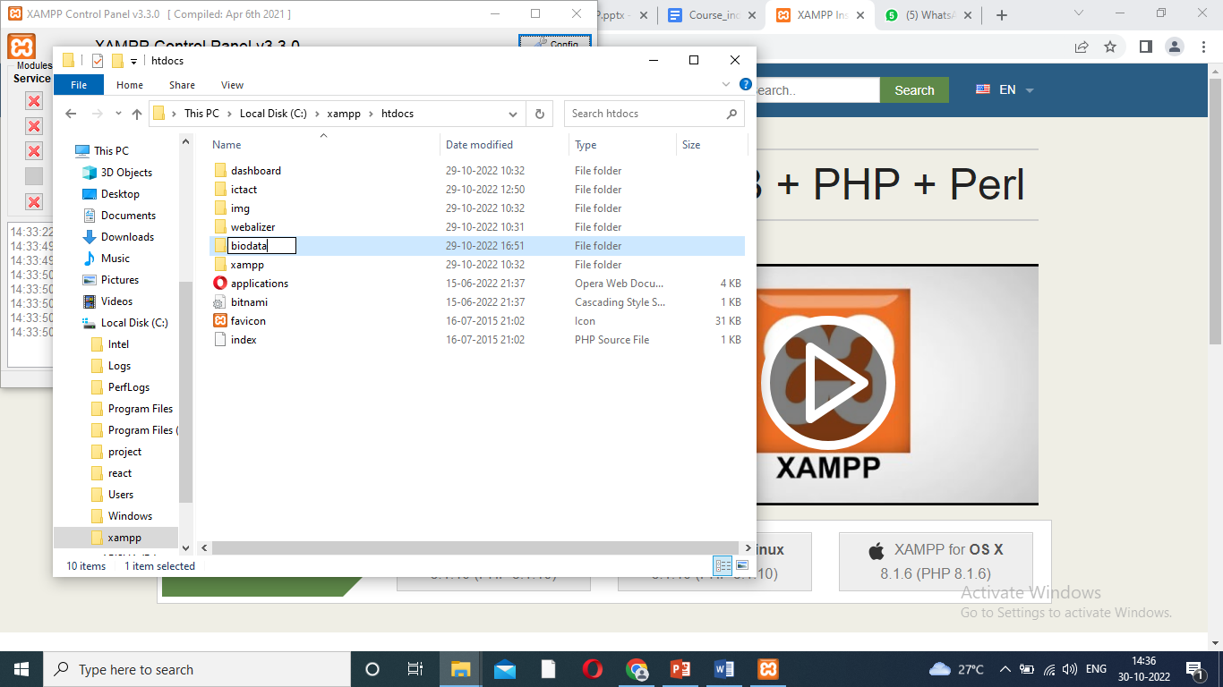
Root folder

Slide 7
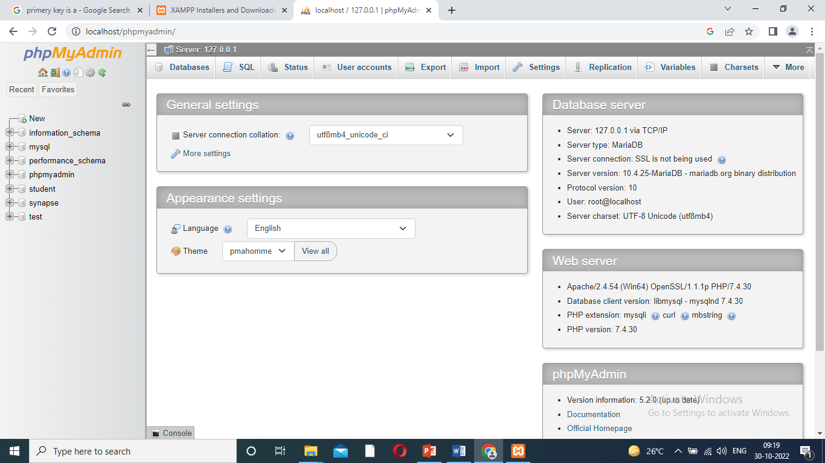
Step:4
Create database.
Google-type-localhost-click phpmyAdmin.
New – click – type biodata –create.

Slide 8
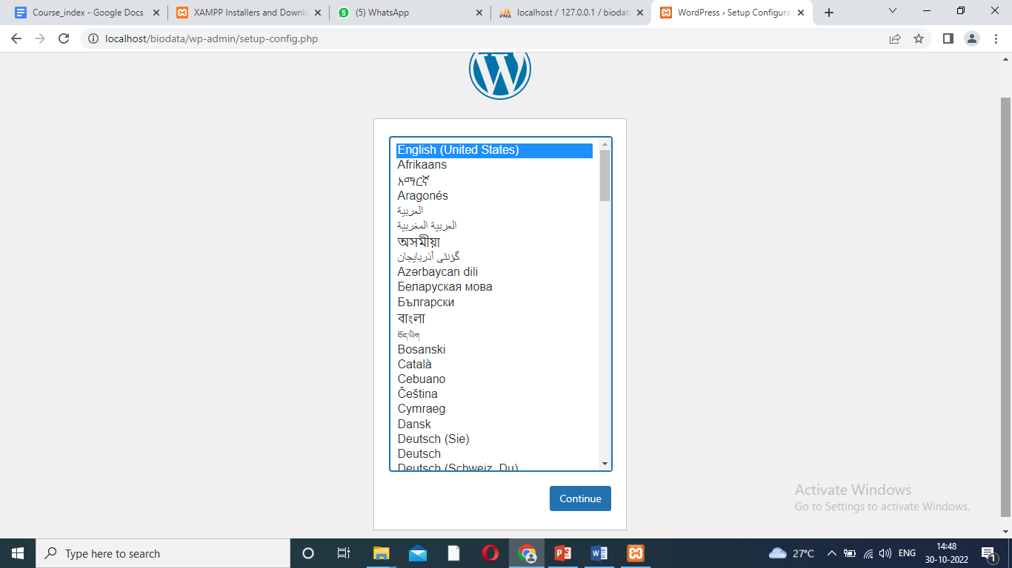
Localhost/biodata
Step:5
Localhost/biodata – WordPress – display window.
Click English– continue –

Slide 9
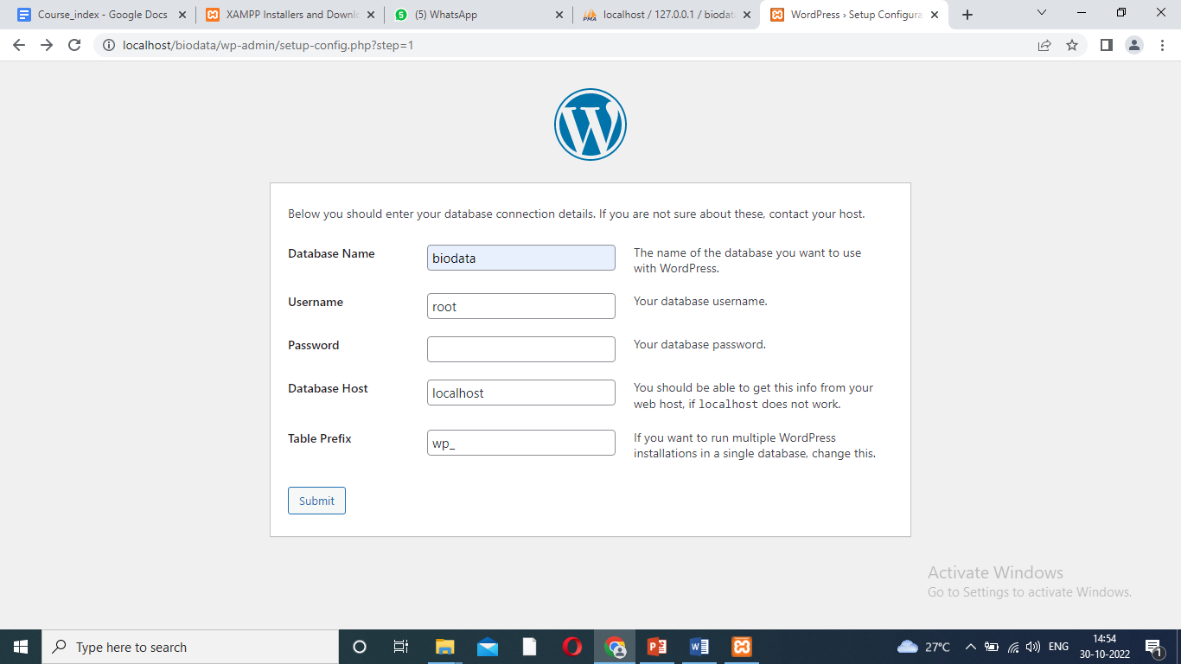
Data base name
Data base name : biodata
User name : root
Table prefix :wb
Password :
Database host :
Click submit – let’s go- run the installation.

Slide 10
Run the installation
Site title :
User name : admin
Password :welcome
Install word press – login – welcome to wordpress.

Slide 11
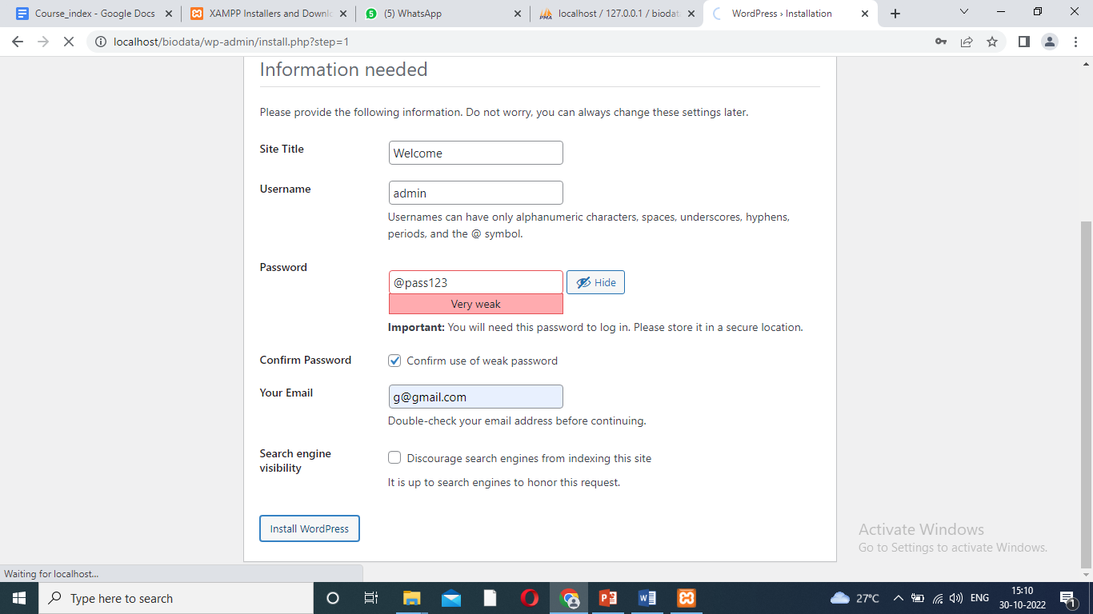
Install WordPress

Slide 12
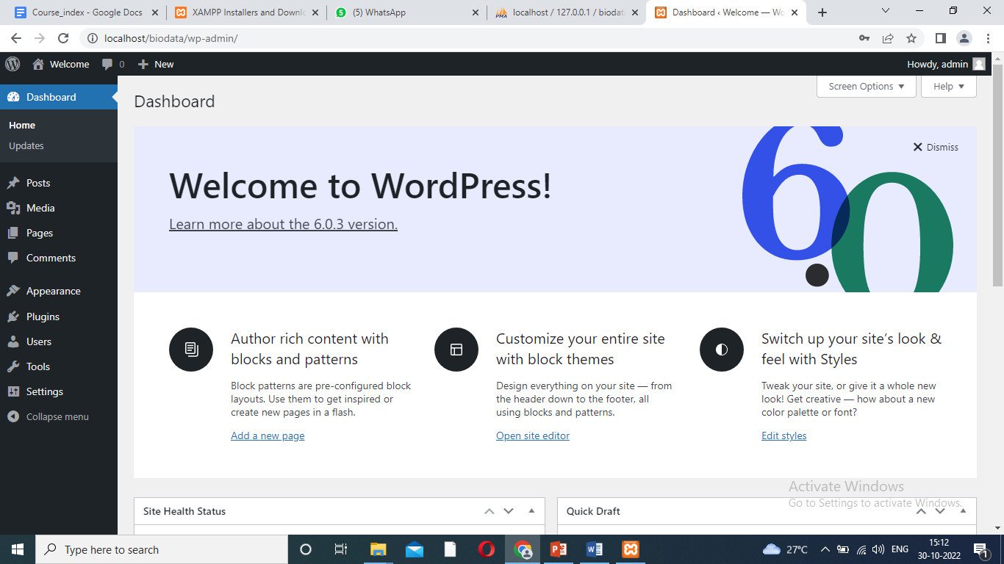
Welcome WordPress

Slide 13
Webpage design
Step:5
Webpage design.
Localhost/ biodata.
Dashboard – all post – add new – publish – view page.
Dashboard – appearance – theme details – update.

Slide 14
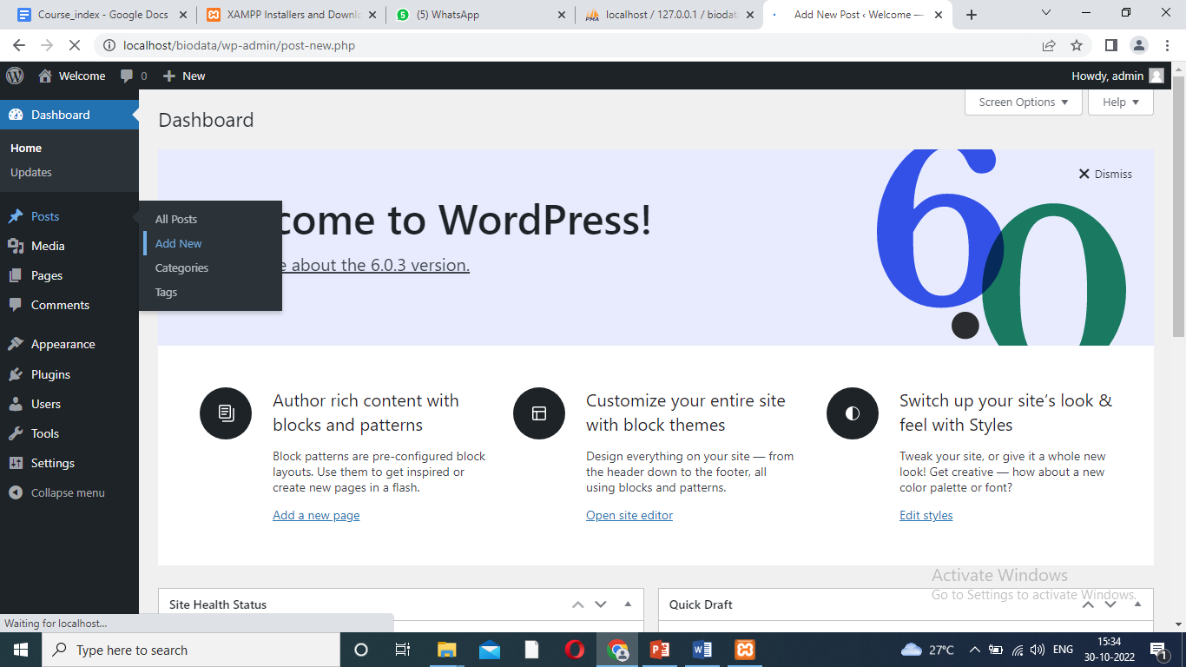
Creating pages
Dashboard – all post – add new – publish – view page.

Slide 15
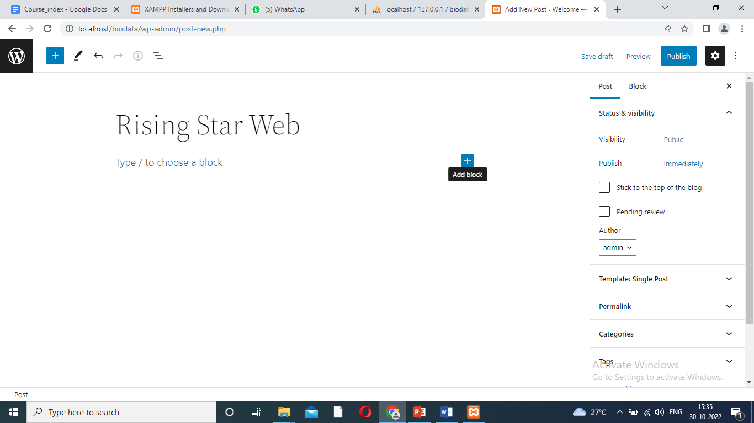
Page creating

Slide 16
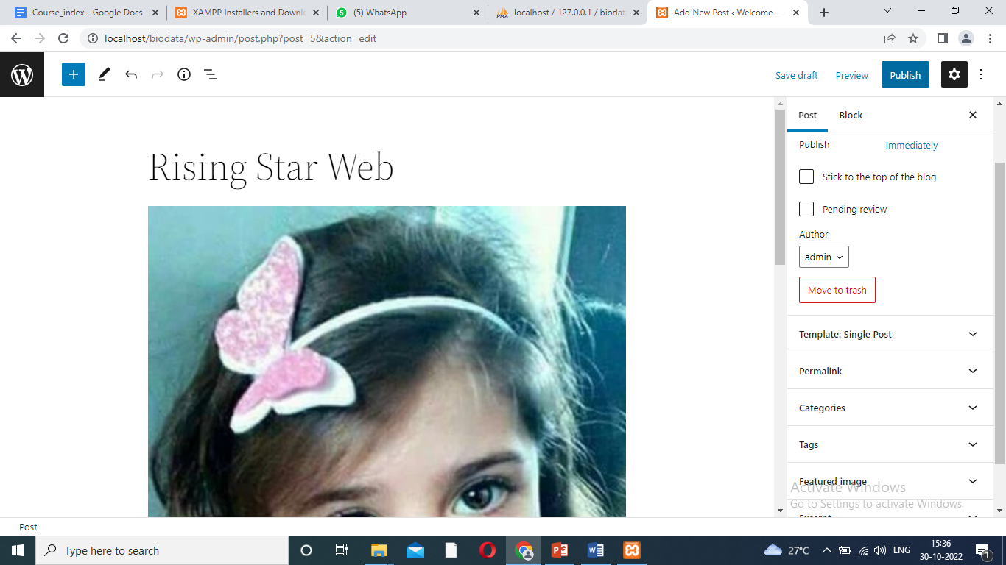
Web page creating design to publish

Slide 17
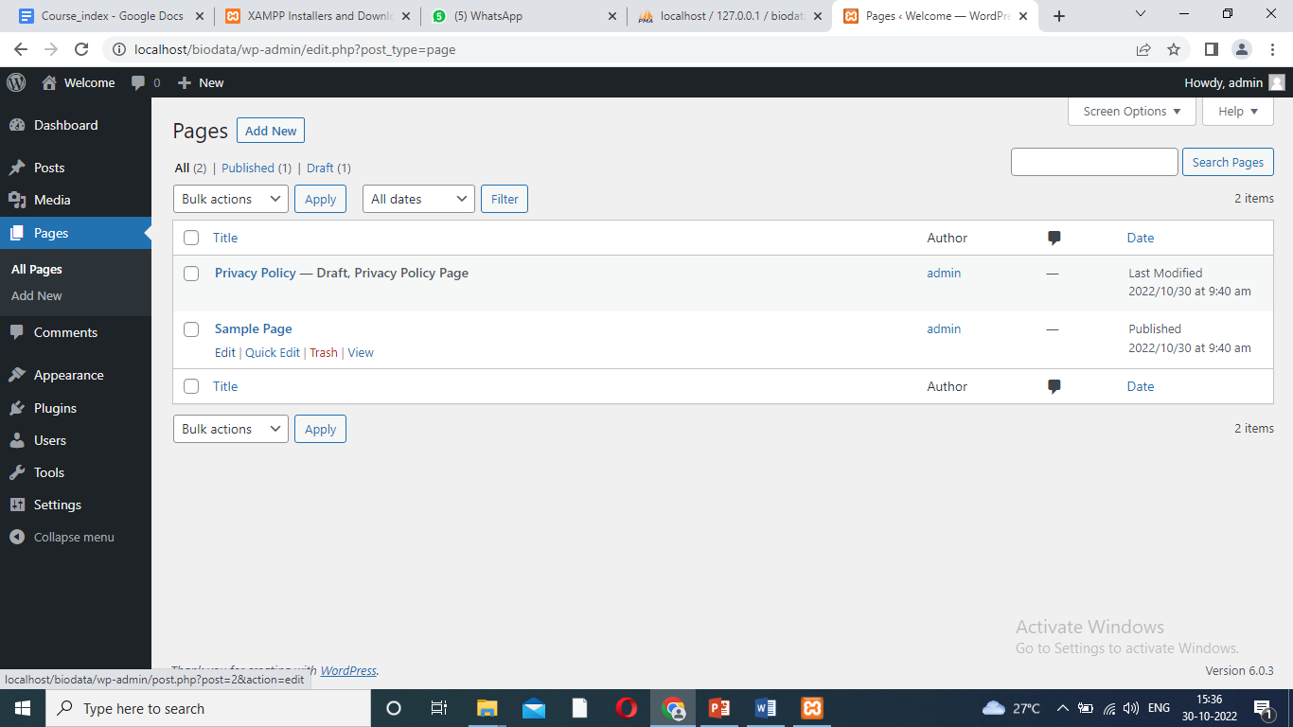
Post Pages

Slide 18
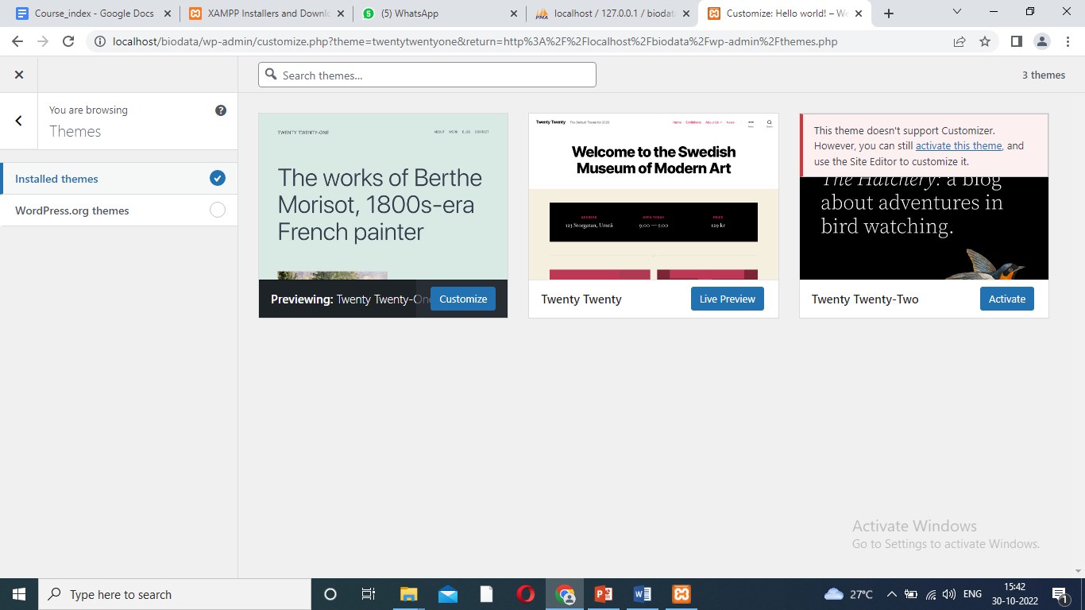
Changing Themes and Plugins
Dashboard – appearance – theme details – update.

Slide 19
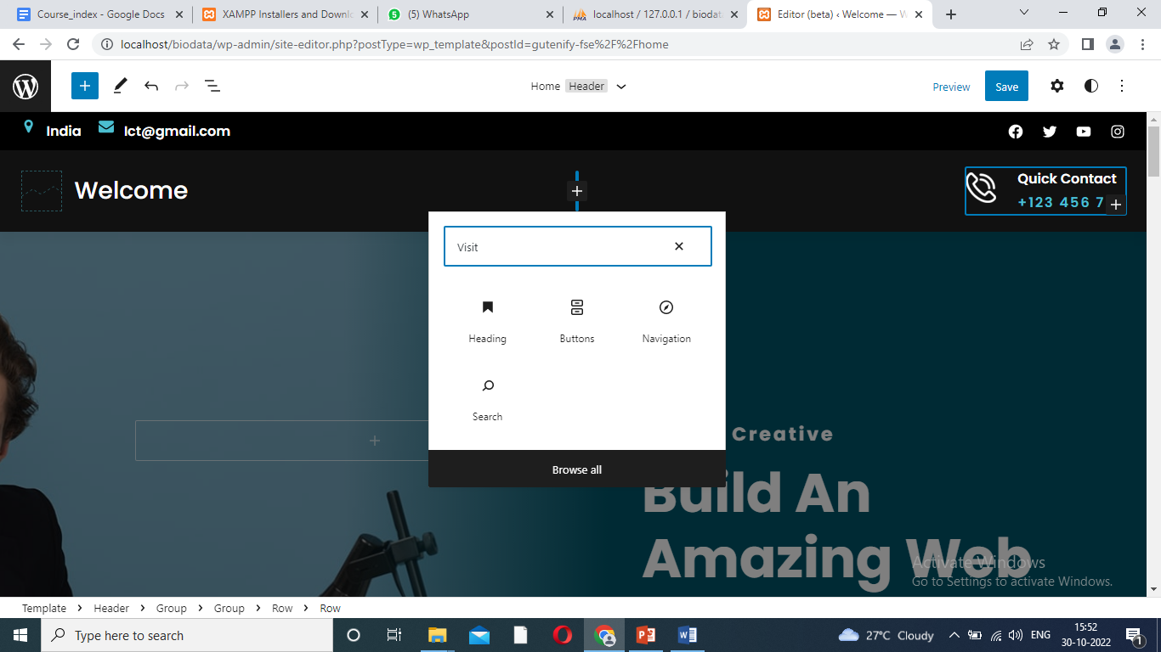
Download themes

Slide 20
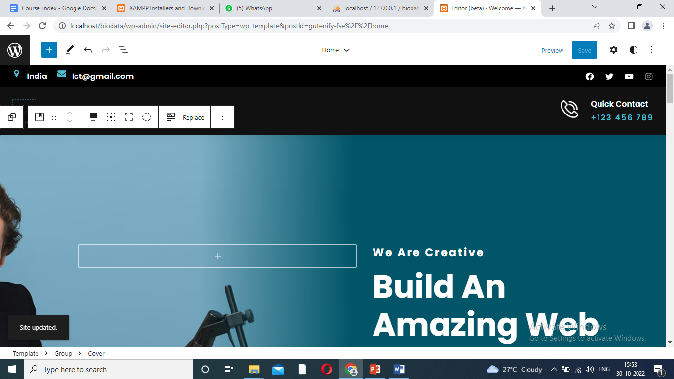
Updating Webpage

